Slide 1
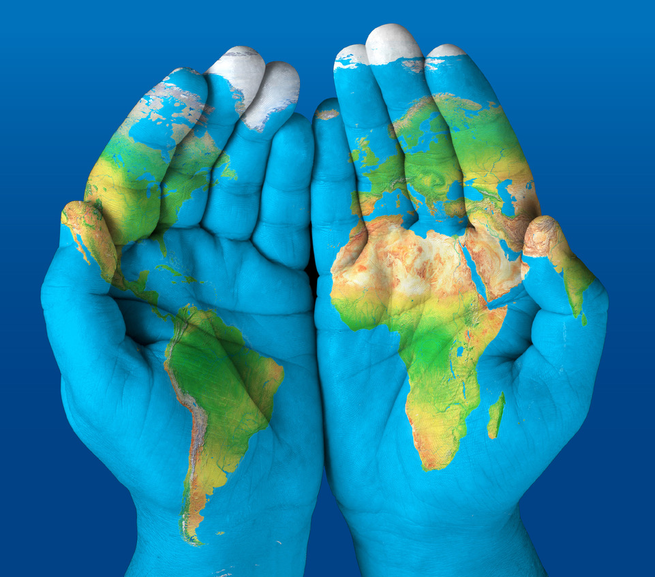
Door-to-Needle Time for Acute Ischemic Stroke: Predicting time from hospital arrival to initiation of thrombolytic therapy
BST209
Group 2
Crystal, David, Alon, Renata, Chrystinne

Slide 2
Background
Door-to-Needle Time for Acute Ischemic Stroke: Time from hospital arrival to initiation of thrombolytic therapy.
^{Importance:}
Speed is crucial: "Time is Brain."
Early treatment improves outcomes & reduces disability.
^{Thrombolysis:}
^{Alteplase (tPA) is a key drug.}
Can dissolve the clot & restore blood flow.
^{Recommendations:}
Target: Administer tPA within 60 minutes of hospital arrival.
Some guidelines suggest an ideal goal of 45 minutes.
^{Challenges:}
^{Accurate & rapid diagnosis.}
System inefficiencies & delays.
^{Potential risks of treatment.}
^{Impact:}
Reducing door-to-needle time = Better patient prognosis.
Quality measure for stroke care in hospitals.
Patient race is known to affect door-to-needle time.

Slide 3

Problem definition
How effectively can an in silico classification model predict prolonged door-to-needle times in acute ischemic stroke patients?
Does our model suggest patient race influences door-to-needle time in this dataset?
What other features are influential to door-to-needle time?
Do we also suspect our model will be biased in its predictions toward certain groups?

Slide 4
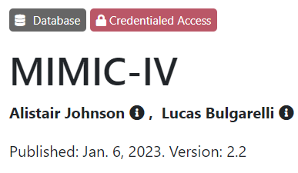
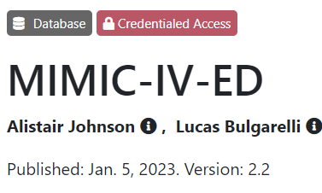
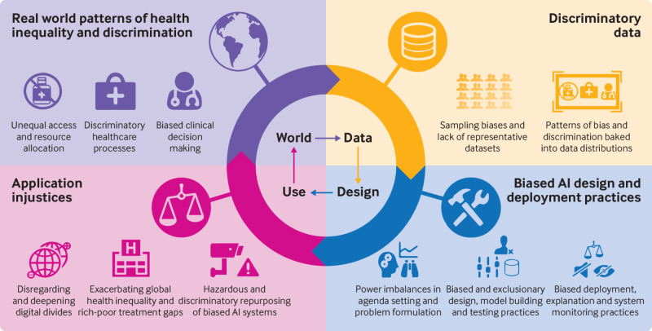
Dataset
Clinical Cohort for MIMIC-IV/ED
Presentation at BIDMC ED between 2011-2019, ~425,000 stays
Excluded if younger than 18 years on first visit
Data collected from EHR as part of routine clinical care not for research purposes
Imbalanced Representation?
Disparity in Data Quality?
Groups who did not present to hospital/ICU (fear, financial, transportation, etc.)
Groups who have missing/incorrect values in routine care/EHR or who do not have EHR (data skew, unexpected values, missing values)
Minority groups, from rural areas, undereducated, lower socioeconomic classes (demographic bias)
More severe disease (ICU bias)
Temporal bias
Leslie, D. et al (2021)

Slide 5

Hypothesis
The in silico model can predict prolonged door-to-needle times in acute ischemic stroke patients with a high degree of accuracy; however, there may be significant disparities in prediction accuracy across different racial or demographic groups, indicating potential biases within the model.

Slide 6
Inclusion and exclusion criteria and outcome
MIMIC IV-ED
n= 205,504
Inclusion Criteria:
Adult >18
Alteplase listed as administered in Pyxis table (mimiciv_ed.pyxis)
Exclusion criteria
Diagnosis of PE or cardiac arrest
Administration of TPA >4.5 hours after ED presentation
Excluded n = 204,945
Patients who received alteplase
n= 559
Outcome
Time-to-thrombolytics/door-to-needle
Time of ED presentation subtracted from time of thrombolytics administration
Exclude diagnosis of pulmonary embolism or cardiac arrest
n= 21
Cohort of interest
n=538
Notes:
Clinical Presentation:
Acute onset of neurological deficits consistent with ischemic stroke.
Symptoms onset to hospital presentation within 4.5 hours.
Imaging:
CT or MRI confirmation of ischemic stroke without evidence of intracranial hemorrhage.
Age:
Adult patients (i.e., 18 years and above).
Consent:
Informed consent obtained from the patient or a legally authorized representative
Hemodynamic Stability:
Systolic and diastolic blood pressure below a certain threshold
Blood Tests:
Acceptable platelet count
No significant coagulopathy

Slide 7
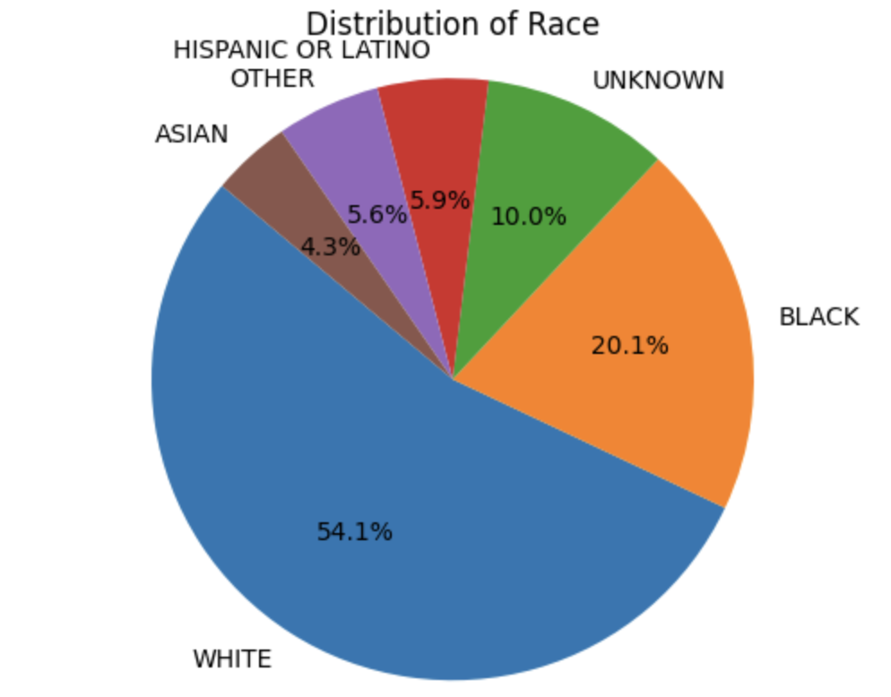
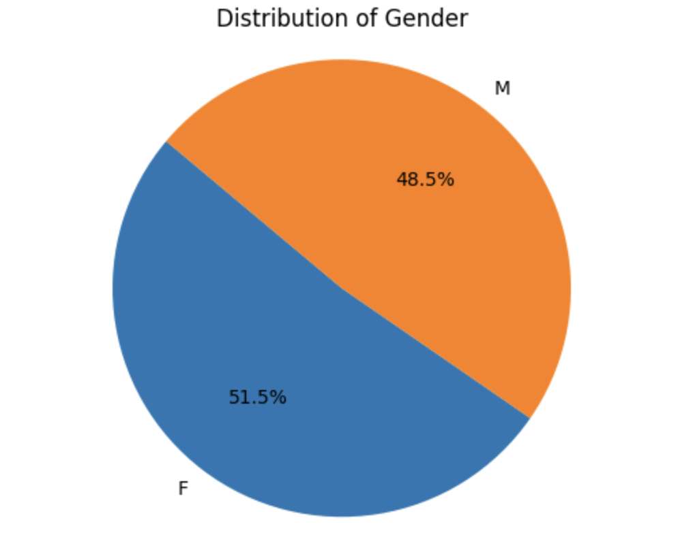
Cohort demographics
Illustrations created and generously provided by Renata Proa!

Slide 8
Inclusion and exclusion criteria - bias
Bias associated with Inclusion/Exclusion Criteria
Only analyzing patients who received TPA within 4.5 of presentation
Patients who inappropriately DID NOT receive TPA not captured
This is likely a source of bias

Slide 9
Features
Patient Demographics:
Age, gender, socioeconomic status
Race/Ethnicity: Key focus on potential racial disparities [bias due to self-reporting]
Clinical Variables:
Severity of stroke (NIHSS) [bias due to objectivity of clinician]
Comorbid conditions (e.g., hypertension, diabetes, atrial fibrillation)
Prior stroke history
Presenting Symptoms:
Aphasia, hemiparesis, facial droop, visual disturbances [bias due to objectivity of clinician]
Laboratory Results:
Blood glucose levels, platelet count, INR (for patients on anticoagulants)
Medication Use:
Current anticoagulant or antiplatelet therapy
Recent use of thrombolytics or anticoagulants
Other medications that might affect treatment decisions
Treatment Factors:
Time of arrival
Mode of arrival (e.g., ambulance, walk-in) [socioeconomic bias]
Geographical Factors:
Urban vs. rural [bias]
Cultural & Social Factors:
Patient’s health literacy/education level [bias]
Language barriers [bias]

Slide 10
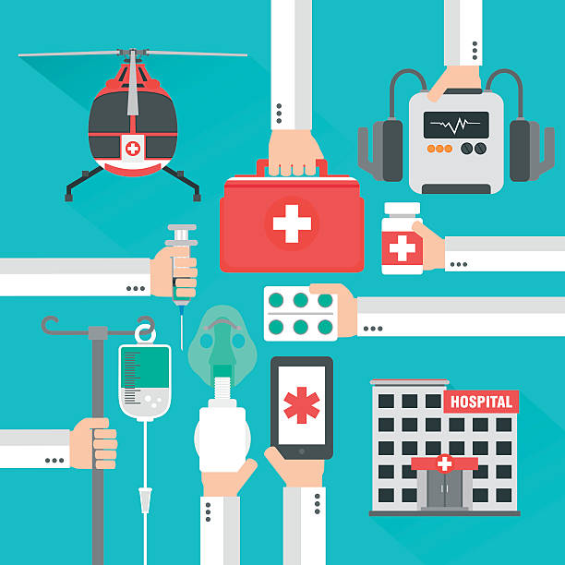
Evaluation
Evaluation of in silico Model Implementation in ED
Implementation would be best at the departmental level as a process improvement tool to identify main contributing factors to delays in door-to-needle time
Predictions must be explainable so that interventions can be taken in cases of predicted long door-to-needle time
Unintended consequences:
Operates under assumption that faster intervention is always better
Could lead to rushed diagnosis and inappropriate treatment (stroke mimics)
Biased against underrepresented groups

Slide 11
References
Faigle R, Urrutia VC, Cooper LA, Gottesman RF. Individual and System Contributions to Race and Sex Disparities in Thrombolysis Use for Stroke Patients in the United States. Stroke. 2017 Apr;48(4):990-997. doi: 10.1161/STROKEAHA.116.015056. Epub 2017 Mar 10. PMID: 28283607; PMCID: PMC5399516.
Goldberger, A., Amaral, L., Glass, L., Hausdorff, J., Ivanov, P. C., Mark, R., ... & Stanley, H. E. (2000). PhysioBank, PhysioToolkit, and PhysioNet: Components of a new research resource for complex physiologic signals. Circulation [Online]. 101 (23), pp. E215–e220.
Johnson, A.E.W., Bulgarelli, L., Shen, L. et al. MIMIC-IV, a freely accessible electronic health record dataset. Sci Data 10, 1 (2023). https://doi.org/10.1038/s41597-022-01899-x
Johnson, A., Bulgarelli, L., Pollard, T., Horng, S., Celi, L. A., & Mark, R. (2023). MIMIC-IV (version 2.2). PhysioNet. https://doi.org/10.13026/6mm1-ek67.
Johnson, A., Bulgarelli, L., Pollard, T., Celi, L. A., Mark, R., & Horng, S. (2023). MIMIC-IV-ED (version 2.2). PhysioNet. https://doi.org/10.13026/5ntk-km72.
Leslie D, Mazumder A, Peppin A, Wolters MK, Hagerty A. Does "AI" stand for augmenting inequality in the era of covid-19 healthcare? BMJ. 2021 Mar 15;372:n304. doi: 10.1136/bmj.n304. PMID: 33722847; PMCID: PMC7958301.

Slide 12
Thank you!

